Slide 1

CS302 Design and Analysis of Algorithms
Muhammad sohail afzal

Slide 2
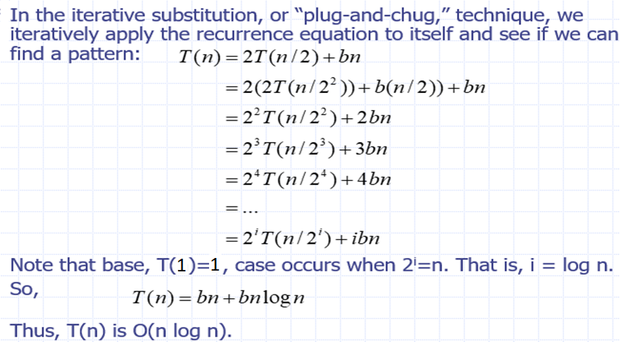
Iterative Substitution: Solving Recurrence

Slide 3
Several Examples : Iterative Substitution
Example 1:
T(n) = 1 + T(n-1)
T(n) = 1 + (1+T(n-2))
T(n) = 2 + T(n-2)
T(n) = 3 + T(n-3)
T(n) = 4 + T(n-4)
…..
T(n) = k + T(n-k)
For k = (n-1)
T(n) = n – 1 + T(1)
T(n) = n
i.e. T(n) = Theta(n)

Slide 4
Several Examples : Iterative Substitution
T(n) = n + T(n-1)
T(n) = n + (n-1+T(n-2))
T(n) = 2n – 1 + T(n-2)
T(n) = 2n -1 + ((n-2) + T(n-3))
T(n) = 3n -3 + T(n-3)
T(n) = 3n -3 + n-3 + T(n-4))
T(n) = 4n – 6 + T(n-4)
…..
T(n) = kn – c + T(n-k)
For k = (n-1)
T(n) = n^2 -1 – c + T(1)
i.e. T(n) = Theta(n^2)
Example 2:

Slide 5
Several Examples : Iterative Substitution
Example 3:
T(n) = 1 + T(n/2)
T(n) = 1 + (1+T(n/4))
T(n) = 2 + T(n/4)
T(n) = 3 + T(n/8)
T(n) = 3 + T(n/2^3)
…..
T(n) = k + T(n/2^k)
For k = logn => n = 2^k
T(n) = logn + T(1)
T(n) = 1 + log(n)
i.e. T(n) = Theta(logn)

Slide 6
Several Examples : Iterative Substitution
SOLVE THESE PROBLEMS YOURSELF :
1) T(n) = n + 2T(n/2)
2) T(n) = 2T(n-1)
3) T(n) = n + T(n/2)

Slide 7
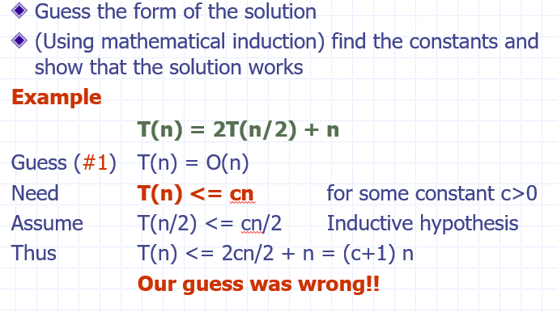
Substitution by Guess and Test Method: Solving Recurrence

Slide 8
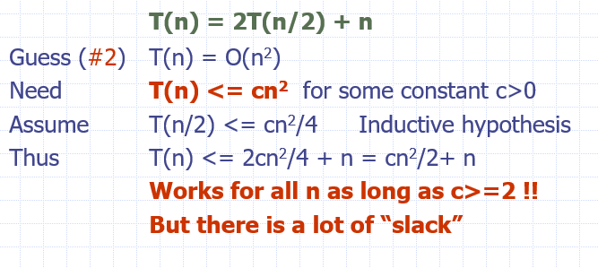
Substitution by Guess and Test Method: Solving Recurrence

Slide 9
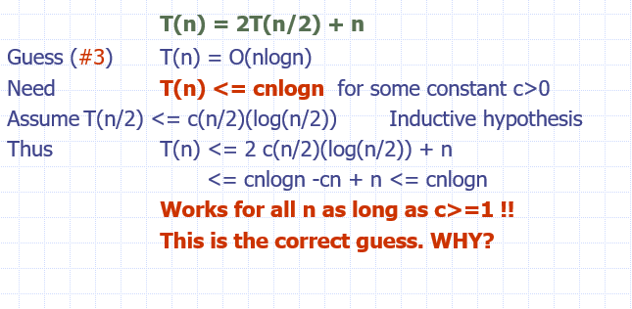
Substitution by Guess and Test Method: Solving Recurrence

Slide 10
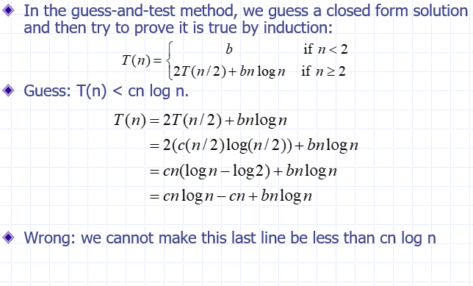
Substitution by Guess and Test Method: Solving Recurrence

Slide 11
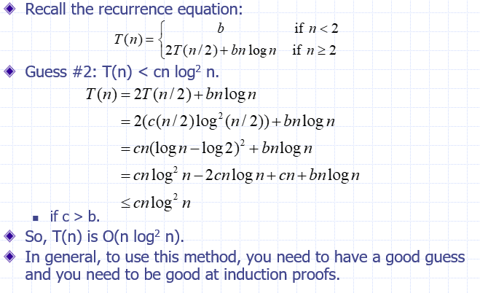
Substitution by Guess and Test Method: Solving Recurrence

